Slide 1
SECOND INDIVIDUAL PRESENTATION- GROUP 5
INTERFACING SENSOR TO ARDUINO UNO AND DESIGN MACHINE LEARNING ALGORITHM
INSTRUCTOR: PROF. MIKE ALESHAMS
PRESENTER: SOUMYA THAZHATHU PANCHICKAL(C0753009)

Slide 2
Gesture Keyboard- Typing letters by moving in the air with machine learning using Beaglebone Black
The aim of this project is to type letters in the air using hand gestures, where the gestures are sensed by a gyroscope and finally displayed on an LCD display.
The main components used are Beaglebone black, Arduino board, Gyroscope and LCD display.
The machine learning algorithm "Supervised learning" is used with some predictions along with designed project to detect the alphabet. The gyroscope is attached to hand, so when letters are written in air, the data is transferred to the beaglebone black via arduino, where the data is compared with machine algorithm predictions and then, they are displayed.

Slide 3
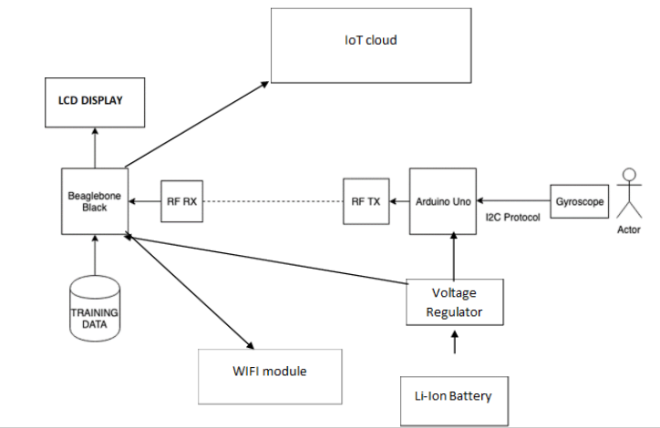

Slide 4
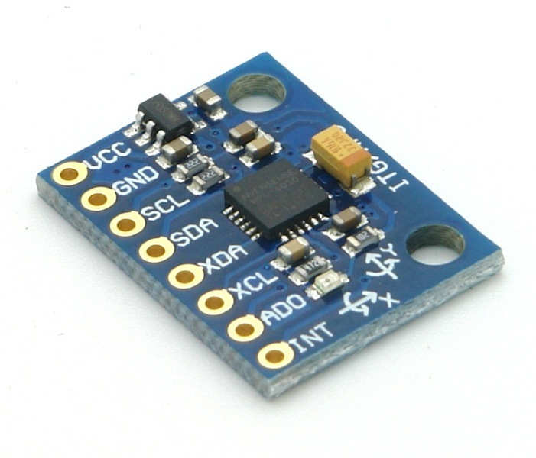
INTERFACING GYROSCOPE SENSOR TO ARDUINO UNO
GYROSCOPE SENSOR
MPU6050 sensor module is an integrated 6-axis Motion tracking device.
It has a 3-axis Gyroscope, 3-axis Accelerometer, Digital Motion Processor and a Temperature sensor, all in a single IC.
It can accept inputs from other sensors like 3-axis magnetometer or pressure sensor using its Auxiliary I2C bus.

Slide 5
The MPU-6050 module has 8 pins,
INT: Interrupt digital output pin.
AD0: I2C Slave Address LSB pin. This is 0th bit in 7-bit slave address of device. If connected to VCC then it is read as logic one and slave address changes.
XCL: Auxiliary Serial Clock pin. This pin is used to connect other I2C interface enabled sensors SCL pin to MPU-6050.
XDA: Auxiliary Serial Data pin. This pin is used to connect other I2C interface enabled sensors SDA pin to MPU-6050.
SCL: Serial Clock pin. Connect this pin to microcontrollers SCL pin.
SDA: Serial Data pin. Connect this pin to microcontrollers SDA pin.
GND: Ground pin. Connect this pin to ground connection.
VCC: Power supply pin. Connect this pin to +5V DC supply.

Slide 6
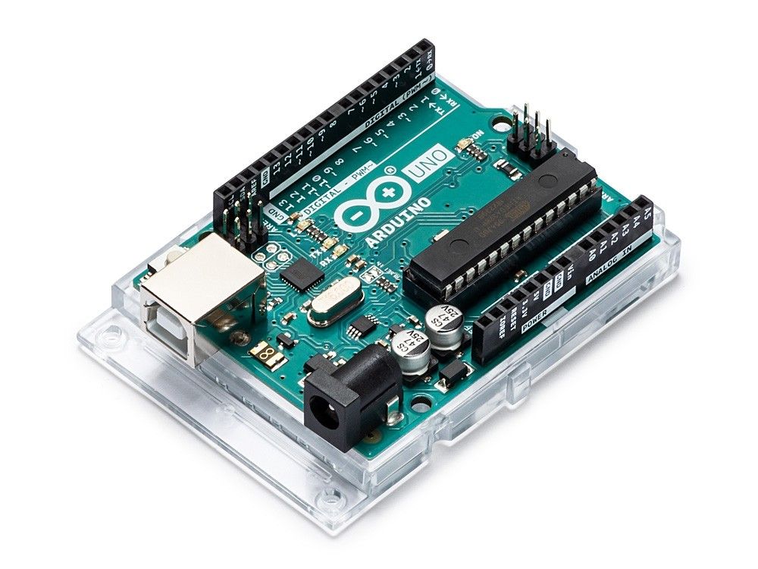
ARDUINO UNO
Microcontroller : Atmega328P
Operating voltage : 5V
Input voltage : 7-12V
Input voltage(limit) : 6-20V
Digital I/O pins : 14
PWM Digital I/O pins : 6
Analog Input pins : 6
DC current per I/O pin : 20 mA
DC current for 3.3V pin : 50 mA
Flash memory : 32 KB
SRAM : 2 KB
EEPROM : 1 KB
Clock speed : 16 MHz

Slide 7
ARDUINO IDE
Arduino IDE is used for coding which has a text editor, tool bar for common functions and series of menus
It connects to the Arduino board to upload the program and establish communication
Serial monitor initiates the exchange of data with any connected board on the currently selected port. Port contains all the serial devices on your machine.

Slide 8
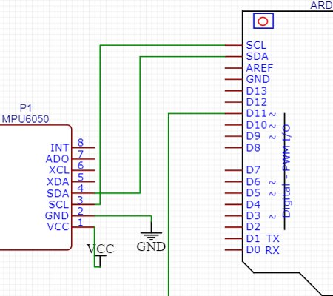
Schematic for Arduino-gyroscope interfacing

Slide 9
Connection details
SDA and SCL of MPU6050 is connected to the SDA and SCL of Arduino board
Pin 12 of the Arduino is connected to one leg of the Switch
GND of Arduino and Sensor is connected to the common ground of the breadboard
5V from Arduino is given to the VCC of the breadboard
VCC from sensor is connected to the common VCC of the breadboard
One leg of the Switch is grounded to the common GND of the breadboard

Slide 10
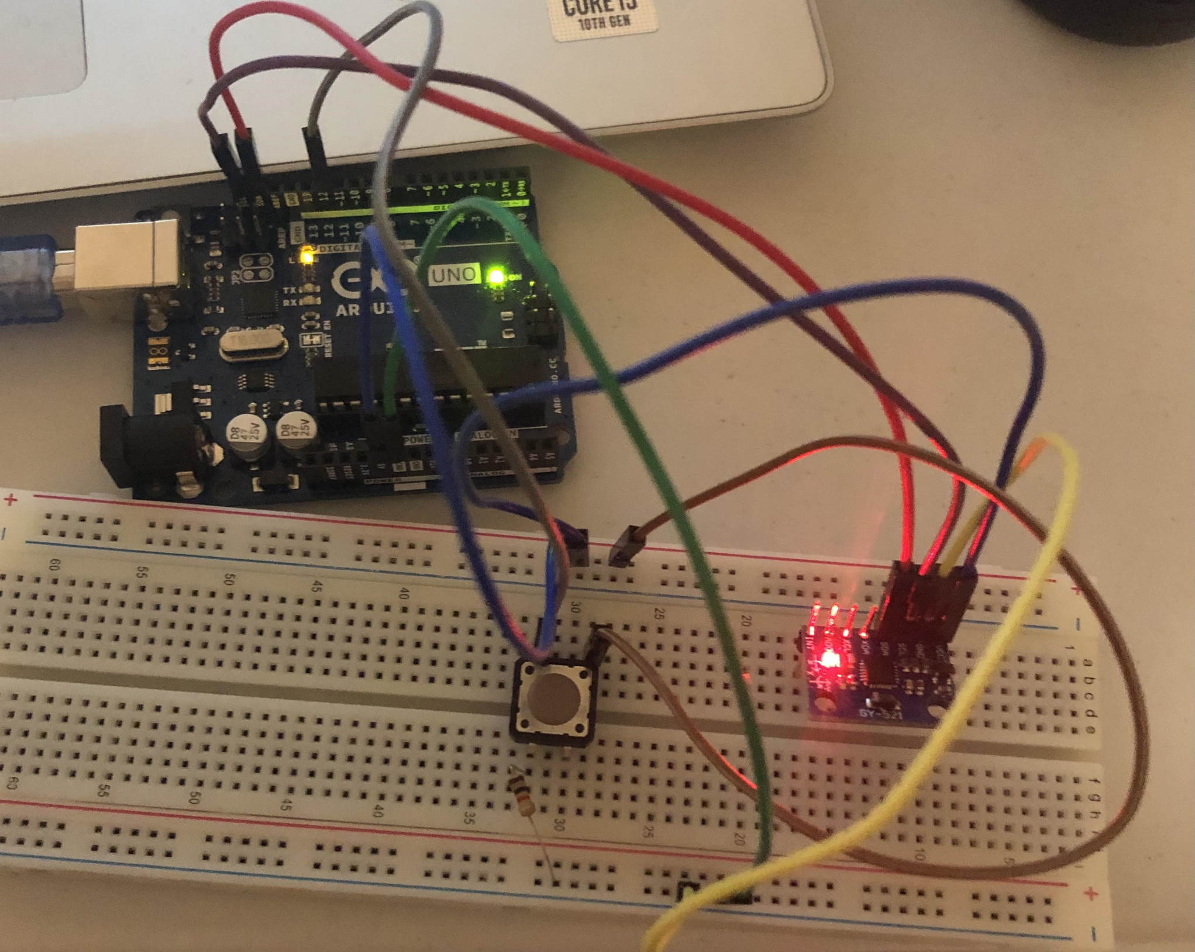
CONNECTING ARDUINO UNO WITH GYROSCOPE SENSOR

Slide 11
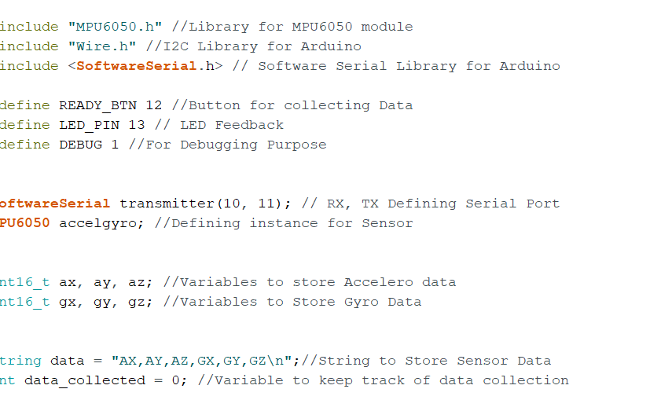
CODE FOR INTERFACING SENSOR WITH ARDUINO BOARD
MPU6050.h- header file : It has I2C communication protocol. The I2C Device Library (i2cdevlib) is a collection of uniform and well-documented classes to provide simple and intuitive interfaces to I2C devices.
Ready_BTN is a switch to store the data

Slide 12
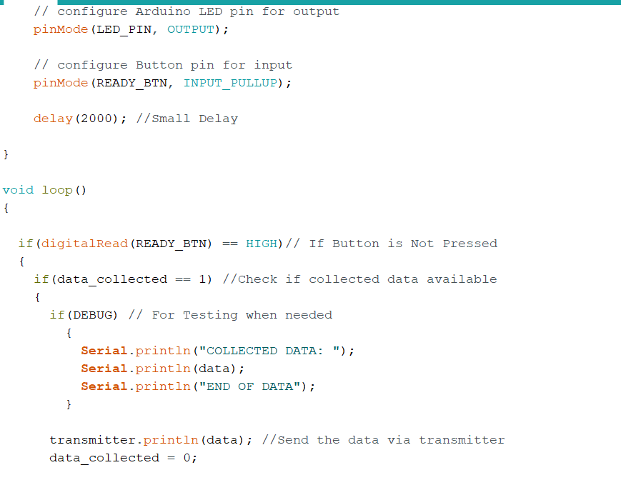
Cont...............
DISPLAYING
DATA
When the Ready_Btn is not pressed,
That is, when the switch is high, data
Collected is available and displayed.
When the switch is pressed and
Button is low, no data is collected.
Datas are collected and displayed
when button is released

Slide 13
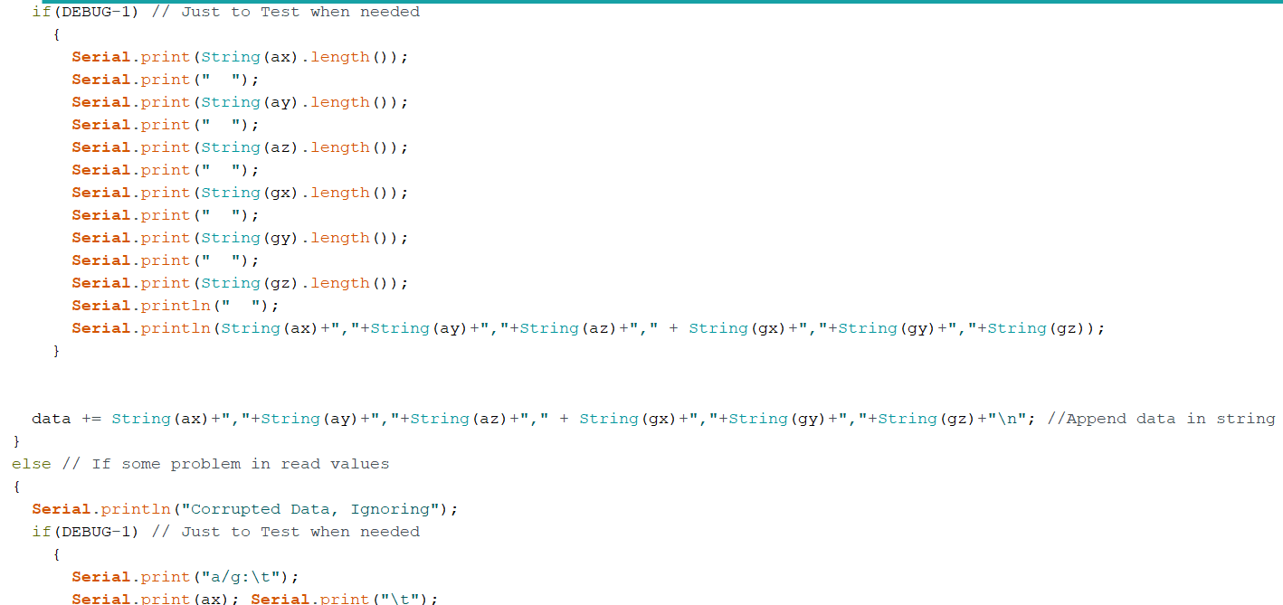
Cont..............
Appending the data in string format

Slide 14
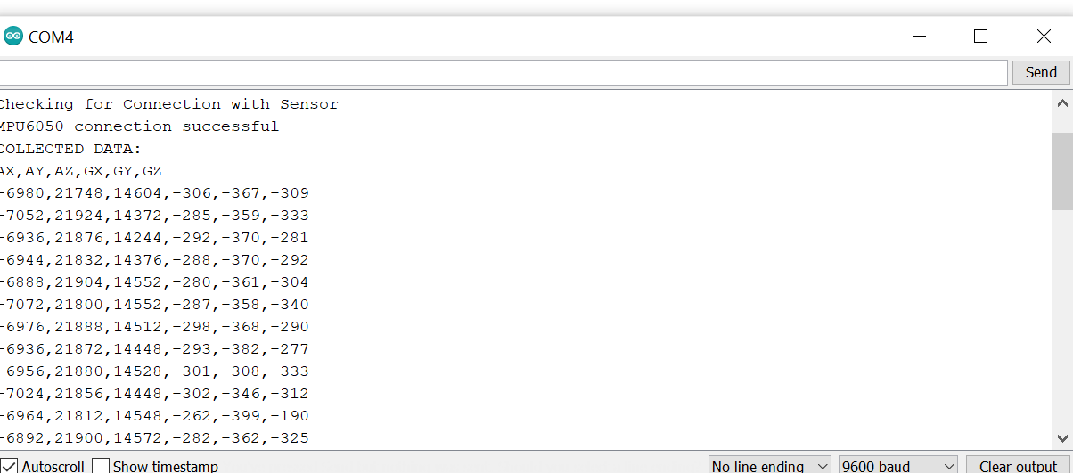
ACCELEROMETER AND GYROSCOPE VALUES

Slide 15
DESIGNING MACHINE LEARNING ALGORITHM
Random forest is a type of supervised machine learning algorithm based on ensemble learning. Ensemble learning is a type of learning where you join different types of algorithms or same algorithm multiple times to form a more powerful prediction model. The random forest algorithm combines multiple algorithm of the same type i.e. multiple decision trees, resulting in a forest of trees, hence the name "Random Forest".
Random forest algorithm works as following:
Pick N random records from the dataset.
Build a decision tree based on these N records.
Choose the number of trees you want in your algorithm and repeat steps 1 and 2.
In case of a regression problem, for a new record, each tree in the forest predicts a value for Y (output)

Slide 16
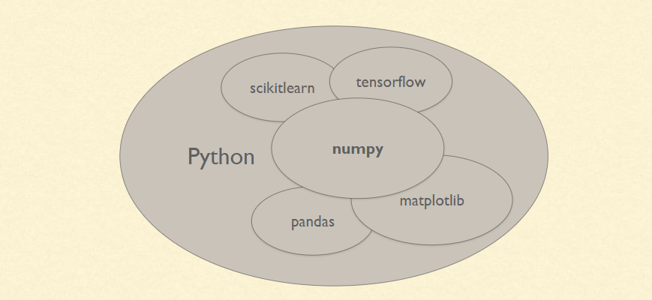
Machine learning libraries in python

Slide 17
SCIKIT LEARN (Sklearn)
Scikit-learn is a free machine learning library for python. It features various algorithms like random forest, K-neighbors etc.
Almost all the popular supervised learning algorithms, like Linear Regression, Support Vector Machine (SVM), Decision Tree etc., are the part of scikit-learn
We use the random forest algorithm via the Scikit-Learn Python library. The following codes are executed to import library:
import pandas as pd
import numpy as np

Slide 18
Numpy
NumPy stands for ‘Numerical Python’. It is an open source module of Python which provides fast mathematical computation on arrays and matrices. Since, arrays and matrices are an essential part of the Machine Learning ecosystem, NumPy along with Machine Learning modules like Scikit-learn, Pandas, Matplotlib, TensorFlow, etc. complete the Python Machine Learning Ecosystem. Numpy is imported as:
>>import numpy as np

Slide 19
Some of the attributes of Numpy are:
Ndim: displays the dimension of the array
Shape: returns a tuple of integers indicating the size of the array
Size: returns the total number of elements in the NumPy array
Dtype: returns the type of elements in the array, i.e., int64, character
Itemsize: returns the size in bytes of each item
Reshape: Reshapes the NumPy array

Slide 20
Pandas
Pandas is one of the most widely used python libraries in data science. It provides high-performance, easy to use structures and data analysis tools. Unlike NumPy library which provides objects for multi-dimensional arrays, Pandas provides in-memory 2d table object called Dataframe. It is like a spreadsheet with column names and row labels.
Pandas are imported as:
>>import pandas as pd

Slide 21

TENSOR FLOW
Tensor flow is an open source library for machine learning. It can be used across a load of tasks and used for training datas.
Currently, the most famous deep learning library in the world is Google's TensorFlow.
Google product uses machine learning in all of its products to improve the search engine, translation, image captioning or recommendations.

Slide 22
ARCHITECTURE OF TENSORFLOW
Tensorflow architecture works in three parts:
Preprocessing the data
Build the model
Train and estimate the model
It is called Tensorflow because it takes input as a multi-dimensional array, also known as tensors. You can construct a sort of flowchart of operations (called a Graph) that you want to perform on that input. The input goes in at one end, and then it flows through this system of multiple operations and comes out the other end as output.

Slide 23
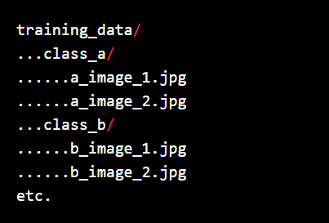
Keras Preprocessing
Keras dataset preprocessing utilities, located at tf.keras.preprocessing, help you go from raw data on disk to a tf.data.Dataset object that can be used to train a model.
From keras.preprocessing.sequence import pad_sequences
Masking is a way to tell sequence-processing layers that certain timesteps in an input are missing, and thus should be skipped when processing the data.
Padding is done in order to make all sequences in a batch fit a given standard length, it is necessary to pad or truncate some sequences.

Slide 24
Arguments
sequences | List of sequences (each sequence is a list of integers).
maxlen | Optional Int, maximum length of all sequences. If not provided, sequences will be padded to the length of the longest individual sequence.
dtype | (Optional, defaults to int32). Type of the output sequences. To pad sequences with variable length strings, you can use object.
padding | String, 'pre' or 'post' (optional, defaults to 'pre'): pad either before or after each sequence.
truncating | String, 'pre' or 'post' (optional, defaults to 'pre'): remove values from sequences larger than maxlen, either at the beginning or at the end of the sequences.

Slide 25
JOBLIB
Joblib is a set of tools to provide lightweight pipelining in Python. In particular:
transparent disk-caching of functions and lazy re-evaluation (memorize pattern)
easy simple parallel computing
joblib.dump and joblib.load provide a replacement for pickle to work efficiently on arbitrary Python objects containing large data, in particular large numpy arrays.
>>from joblib import dump, load
>>import numpy as np

Slide 26
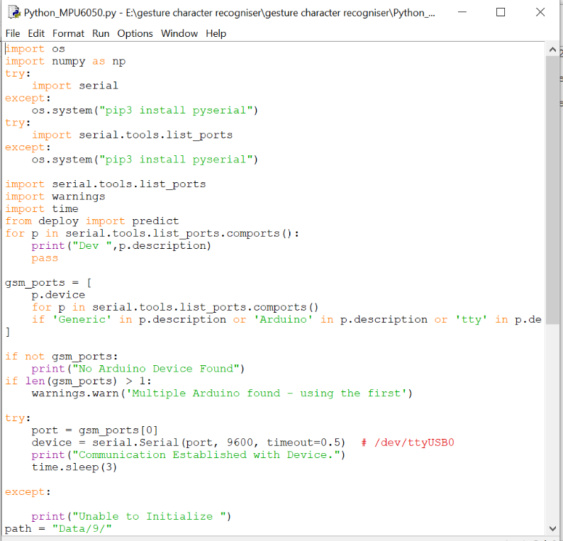
Python code for machine learning

Slide 27
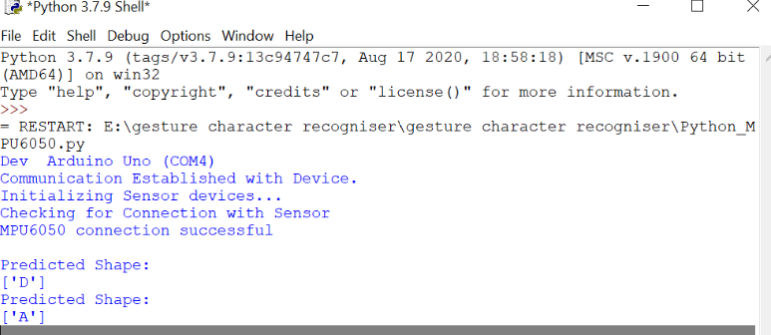
MACHINE LEARNING OUTPUT THROUGH SENSOR AND ARDUINO

Slide 28
REFERENCES
Electronicwings(n.d.). MPU6050 interfacing with Arduino UNO. Retrieved October 30,20 from https://www.electronicwings.com/arduino/mpu6050-interfacing-with-arduino-uno#
Arduino(n.d.). Arduino software IDE. Retrieved October 30,2020, from https://www.arduino.cc/en/guide/Environment
Tutorial gyroscope and accelerometer. Retrieved November1,2020 from https://www.youtube.com/watch?v=wTfSfhjhAU0
Stack Abuse(n.d). Random forest algorithm with python and Scikit-learn. Retrieved November 02,2020 from https://stackabuse.com/random-forest-algorithm-with-python-and-scikit-learn/
Cloud X Lab(n.d). NumPy and Pandas Tutorial – Data Analysis with Python. Retrieved November 07,2020 from https://cloudxlab.com/blog/numpy-pandas-introduction/

Slide 29
Guru99(n.d). What is Tensorflow?. Retrieved November 07,2020 from https://www.guru99.com/what-is-tensorflow.html#1
Joblib(n.d). Persistence. Retrieved from https://joblib.readthedocs.io/en/latest/persistence.html#

